Slide 1


Why Your Feedback Matters!
End-of-Semester Course Evaluations
University of Maryland, Baltimore
School of Nursing

Slide 2
What are Course Evaluations for?
Course evaluations are vital for ensuring quality education and ongoing program improvement at UMSON .
They fulfill several important roles:
Accreditation Compliance: Evaluations demonstrate adherence to accreditation standards, helping programs maintain their status.
Course Quality Assurance: Feedback from students highlights strengths and areas for improvement in courses delivery and teaching.
Student Feedback: Evaluations allow students to express their experiences, enabling faculty to adapt their teaching methods accordingly.
Faculty Evaluation: Student feedback contributes to annual evaluations and decisions regarding ongoing employment and promotion.
Faculty Development: Results identify areas for faculty support and training, enhancing teaching effectiveness.
Curriculum Development: Evaluation data guide curriculum revisions to align with the evolving needs of the nursing profession.
Continuous Improvement: Regular assessments foster a culture of growth, allowing faculty to refine practices and improve student learning outcomes.

Slide 3
Importance of Your Voice
Helps instructors understand student needs
Shapes future course offerings
Teaching excellence matters
How is Your Feedback Used?
In addition to course faculty, the academic deans and department chairs are also responsible for reviewing the Course Evaluation results every semester.
When a course CEQ mean rating below benchmark, the academic dean meets and discusses the evaluation results with the department chair to determine issues and actions.
When a course FEQ mean rating below benchmark, the department chair meets and discusses with the individual faculty member to determine issues and actions.

Slide 4
Confidentiality Assurance
The UMSON course evaluations are anonymous.
Student feedback on the course evaluations will not affect student grades.
Course evaluation results will be available after the course grades are released.

Slide 5

We Value Your Feedback!
As we seek to improve, your insights are crucial!
UMB Core Value: Integrity and Respect
Be Honest: Your genuine feedback helps us grow.
Be Kind: Remember, there’s a hardworking person on the receiving end, navigating their own challenges.
How to Provide Feedback:
Constructive Comments: Focus on what worked and what could be improved.
Respectful Language: Choose words that uplift and encourage growth.
UMB Core Values
Your voice matters, and we appreciate your thoughtful input!

Slide 6

Provide Constructive Feedback
Highlight both strengths and areas for improvement, offering actionable suggestions while maintaining a positive tone.
For example,
Content Clarity:
"The course materials were well-organized, but some concepts, like [specific topic], could benefit from more detailed explanations or additional resources. Consider incorporating more visual aids or examples to clarify these points."
Engagement and Participation:
"I appreciated the interactive elements of the course, such as group discussions. However, I think more opportunities for small group work would enhance student engagement and allow for deeper discussions on the topics covered."
Instructor Feedback:
"The instructor was knowledgeable and approachable, which I really appreciated. However, receiving more timely feedback on assignments would help me understand my progress better and improve my learning outcomes.”

Slide 7
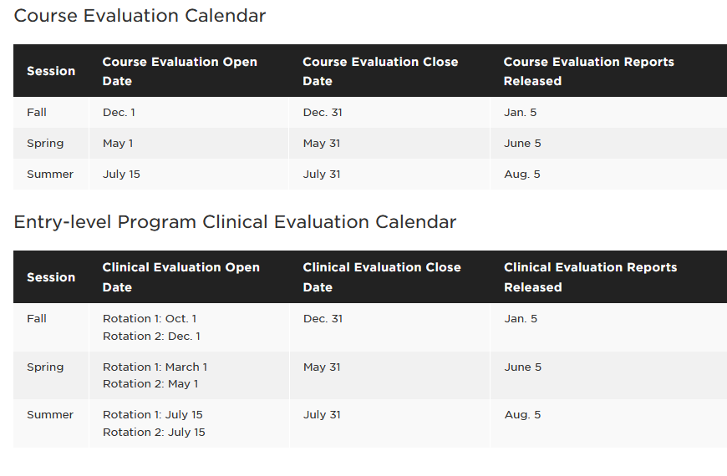
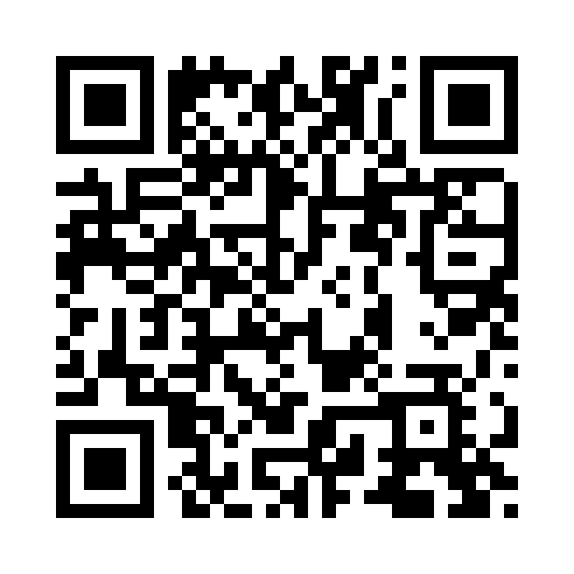
The Evaluation Date
Course Evaluation Login
Course Evaluation Webpage: https://www.nursing.umaryland.edu/student-life/course-evaluations/

Slide 8

Thank You for Your Participation!
“We all need people who will give us feedback. That’s how we improve.”
– Bill Gates

