Slide 1
Office of Research and Scholarship (ORS)
Faculty Orientation
Updated: April 8, 2022
***To open hyperlinks, hover over, right click and select “Open Link.”***

Slide 2
Table of Contents
The Office of Research & Scholarship
UMSON Organized Research Centers (ORC)
Research Quality Improvement
Research Compliance and Education Resources
Pre-Clinical Research Support
ORS Researcher Toolkit
Grants
Writing Support
Pre-Award Process
Post-Award Resources
Statistical Support
Institute for Clinical and Translational Research (ICTR) Resources
UMSON Intranet
UMSON Research Information on the UMSON Intranet
Important UMSON Research Policies and Procedures
Research and Development
Sponsored Programs Administration (SPA): Departing PI Award Disposition
ORS Contact Information

Slide 3
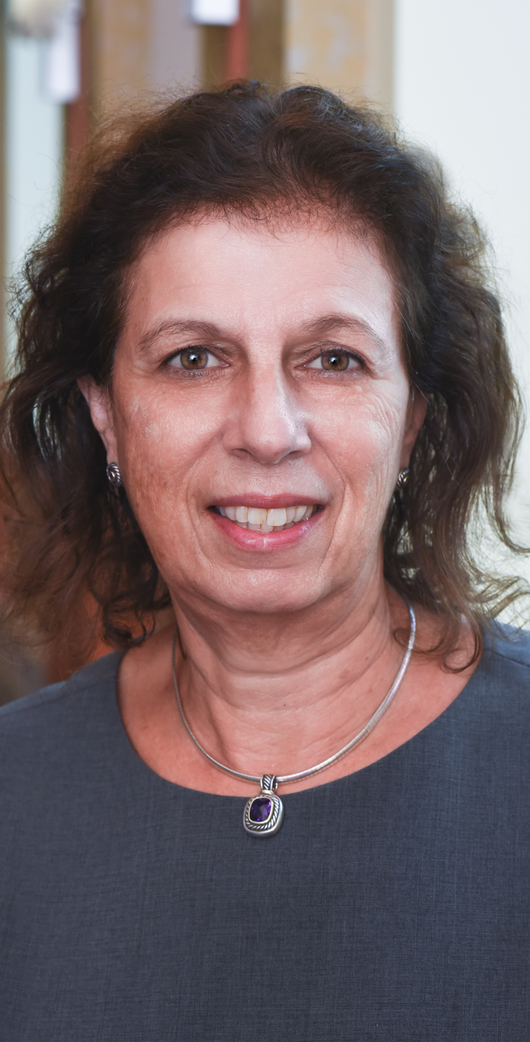
The Office of Research & Scholarship
UMSON’s Office of Research and Scholarship (ORS), led by Erika Friedmann, PhD, Associate Dean for Research, provides an effective infrastructure that partners with faculty members in developing, facilitating, and supporting their research and scholarship goals. The research and scholarship team works with faculty members in the proposal and manuscript development processes; provides statistical support to assist faculty members in their scholarly activities; and assists faculty members and doctoral students in preparing submissions for human subjects research and other regulatory documents. The office assures that all research conducted complies with relevant federal, state, and University research regulations. The ORS collaborates with UMSON Administrative Services’ sponsored program team and collaborates with UMSON’s organized research centers. It also interfaces with other entities within the University System of Maryland and with other universities to promote and facilitate inter-institutional research and scholarship.

Slide 4
UMSON Organized Research Centers (ORC)
Biology and Behavior Across the Lifespan (BBAL) Organized Research Center
BBAL, directed by Eun-Shim Nahm, PhD, RN, FAAN, and Barbara Resnick, PhD, RN, CRNP, FAAN, FAANP, promotes interdisciplinary research related to the influence of biology and behavior on health and health outcomes across the lifespan, providing a core for pooling resources and sharing data across a wide variety of projects.
To be included in the BBAL listserv, contact Barbara Resnick, PhD, RN, CRNP, FAAN, FAANP at resnick@umaryland.edu and and Jennifer Klinedinst, PhD, MPH, RN, FAHA at klinedinst@umaryland.edu.
Mission: The Center for Biology and Behavior Across the Lifespan (BBAL) promotes the conduct of interdisciplinary research related to the influence of biology and behavior on health and health outcomes across the lifespan.
Vision: Our vision is to serve as a center for shared thinking — within the School of Nursing and across the University of Maryland, Baltimore — aimed at the development of pioneering research ideas and interventions to promote and sustain health in all people, from infancy to old age.
Notes:
Biology and Behavior Across the Lifespan (BBAL) Organized Research Center
https://www.nursing.umaryland.edu/research/research-centers/bbal/

Slide 5
UMSON Organized Research Centers (ORC) (Cont.’d)
Center for Health Equity and Outcomes Research (CHEOR)
CHEOR, led by Yolanda Ogbolu, PhD, CRNP-Neonatal, FNAP, FAAN, and Michael Lepore, PhD provides various activities to support its UMSON researchers through collaboration and service to support the mission to improve health outcomes and eliminate health inequities.
Mission: Our mission is to improve health outcomes and eliminate health inequities. We aim to generate knowledge about the complex causal influences that affect health and inequities in outcomes, Identify, intervene, and dismantle social and institutional systems and structures that impede health equity and outcomes, including addressing racism and social determinants of health, and create social impact through changes in policy, clinical, and community practice.
Vision: Our vision is to be a thriving research center for interprofessional scientists to collaborate and act to address complex health outcomes and health inequities through contextually rich research.
To be included in the CHEOR listserv, contact Yolanda Ogbolu, PhD, CRNP-Neonatal, FNAP, FAAN at ogbolu@umaryland.edu.
Notes:
Center for Health Equity and Outcomes Research (CHEOR)
https://www.nursing.umaryland.edu/research/research-centers/cheor/

Slide 6
UMSON Organized Research Centers (ORC) (Cont.’d)
University of Maryland Center to Advance Chronic Pain Research (CACPR)
CACPR, led by Susan G. Dorsey, PhD, RN, FAAN, and Man-Kyo Chung, DMD, PhD is a multidisciplinary center comprising nationally and internationally renowned clinical and preclinical translational scientists whose principal research focus is on the physiological, genetic, and psychosocial underpinnings of the development and persistence of debilitating chronic pain conditions.
Application form to request membership can be found on the CACPR Membership website.
Mission: The mission of the CACPR is to cultivate and expand the cutting-edge multidisciplinary pain research portfolio at the University of Maryland, Baltimore with the overarching goal of improved patient care and quality of life.
Notes:
Center to Advance Chronic Pain Research (CACPR) website: https://www.umaryland.edu/cacpr/about-cacpr/
CACPR Membership application: https://www.umaryland.edu/cacpr/membership/apply/

Slide 7
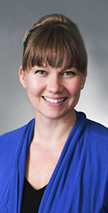
Research Quality Improvement
ORS’s Research Quality Improvement Manager, Casey Jackson, MS, CCRP, works closely with faculty to ensure that good clinical practices are understood and followed through guidance and practice on PI-initiated routine QA monitoring. The position focuses on human subjects research education, which is operationalized through monthly seminars, personal consultations with researchers, and classroom presentations. All seminars are video recorded and available for viewing online. The Research Quality Improvement Manager pre-reviews all institutional review board (IRB) submissions and assists faculty and students in clarifying intent and language. She also assists with understanding the reporting requirements of the IRB and reviews corrective action plans, when needed.
For any questions, please contact Casey Jackson, MS, CCRP at casey.jackson@umaryland.edu.
Notes:
Monthly Research Seminars
https://www.nursing.umaryland.edu/research/seminar-series/

Slide 8
Research Compliance and Education Resources
CICERO – the Online IRB system Support
Assistance with CICERO is available to help researchers navigate and complete the electronic online application for the University of Maryland, Baltimore IRB and prepare the application for continuing review, protocol amendments, and Reportable New Information (RNI).
Individual Consultations
The Research Quality Improvement Manager, Casey Jackson, MS, CCRP, offers one-on-one sessions to assist with human subject research regulatory and compliance issues and can be reached at casey.jackson@umaryland.edu.
Monthly Research Seminars
Seminar topics related to research quality and compliance are held monthly. Certificate of Attendance (COA) is also available for those who attended the entire seminar. List of previous and upcoming research seminars as well as a link to request a COA can be found on the Monthly Research Seminars website.
Quality Assurance Reviews
The Office of Research and Scholarship’s Research Quality Manager conducts the required QA reviews for students, staff, and faculty engaged in all human subject research.
See the Human Subjects Research Compliance and Education webpage or contact Casey Jackson, MS, CCRP at casey.jackson@umaryland.edu.
Notes:
CICERO
https://www.umaryland.edu/hrp/past-announcements/cicero-login.php
Human Subjects Research Compliance and Education
https://www.nursing.umaryland.edu/research/resources/regulatory-affairs/
Monthly Research Seminars
https://www.nursing.umaryland.edu/research/seminar-series/

Slide 9
Pre-Clinical Research Support
Research Involving Animal Subjects
The Office of Research and Scholarship is committed to supporting research initiatives from students and faculty, as well as aiding with pre-award training and protocols, quality improvement, and general oversight. Information on research involving animal subjects, training requirements, and associated standard operating procedures (SOP) can be found in the Pre-Clinical Research Compliance and Education webpage.
Notes:
Pre-Clinical Research Compliance and Education
https://www.nursing.umaryland.edu/research/resources/pre-clinical-research-compliance-and-education/

Slide 10
ORS Researcher Toolkit
To assist researchers with best practices for their human subjects-related research and facilitate their regulatory compliance efforts, the Office of Research and Scholarship (ORS) developed a Researcher Toolkit. The toolkit contains sections on:
Guidance and Training: links to School of Nursing (SON), University of Maryland Baltimore (UMB), and federal human subjects-related research regulations, guidance's, policies, presentations, and instructions
Regulatory Binders and Subject Binders: checklists and optional template documents reference matched to applicable regulations and guidance documents
Quality Assurance: checklists to assist researchers when self-monitoring their studies
Miscellaneous Information
Notes:
Researcher Toolkit
https://www.nursing.umaryland.edu/research/resources/regulatory-affairs/researcher-toolkit/

Slide 11
Grants
ICTR
The Institute for Clinical and Translational Research offers a multitude of funding opportunities including the Voucher Program, Accelerated Translational Incubator Pilot (ATIP) Grant Program, and collaborative awards with the Clinical and Translational Science Award (CTSA) such as the CTSA Program Collaborative Innovation Award (CCIA). Career development and mentorship is also available through the KL2 awards.
Internal
The Office of Research and Scholarship is committed to offering programs that will increase successful grant submissions. The Dean’s Research Scholar and Dean’s Scholarship Scholar awards are offered to faculty members promote research and scholarly activities by offering mentorship or protected time. This information can be found on the Active Research webpage but detailed information and instructions on how to apply for these internal grants are distributed through the UMSON Research listserv.
MPower
MPower promotes cross-institutional as well as cross-disciplinary research by combining the expertise of UMB and University of Maryland College Park researchers and students. The grants offered by MPower are called Seed Grants.
Research Center Grants
UMSON Organized Research Centers provide facilitation awards every semester to assist members with current research efforts. Contact Center Directors for information.
UMNursing Grants
Grants are available for scholars who are looking to partner with a University of Maryland Medical System (UMMS) nurse to research nurse-sensitive outcomes in the hospital or community. Awards are up to $15,000 for one year year.
For any questions regarding any listed grants above, please reach out to DL-nrsresearch@umaryland.edu.
Notes:
Active Research
https://www.nursing.umaryland.edu/research/funded-research/
Center Directors Contact Information
https://www.nursing.umaryland.edu/research/contact-us/
Mpower Seed Grants
https://mpower.maryland.edu/portfolio/seed-grants/
UMB ICTR
https://www.umaryland.edu/ictr/funding/

Slide 12
Writing Support
Editing Services
The Office of Research and Scholarship (ORS) is available to help connect you with editing support for publications and grants. For more information, please reach out to DL-nrsresearch@umaryland.edu.
Health Sciences and Human Services Library (HS/HSL)
The Writing Center and HS/HSL have teamed up and writing consultants are available to for walk-ins, every Wednesday, from 6:00pm-8:00pm in room 128. More info can be found on the HS/HSL Writing Center website.
Scholarly Writing Accountability Groups (SWAG)
SWAG is a peer-led UMB writing group for junior faculty members with a goal to develop sustainable writing habits. For any questions, please contact program director, Stacie Mendoza at smendoza@som.umaryland.edu
Writing Mentorship Groups
UMSON’s Institute for Educators holds regular scholarly writing for publication seminar series to help full-time faculty members develop manuscript to submission. For more information and dates of meetings can be found on the Scholarly Writing Seminar webpage.
School of Medicine Grant Writing Workshops
The School of Medicine’s Center to Advance Research Training and Innovation (CARTI) offers grant writing courses that will provide the basis of writing a competitive K and R grant applications as well as offer resources for writing specific aims among others. This is open to new/junior faculty who are actively working on a grant application. The course meets for 2 hours on a weekly basis. For more information, visit the Grant Writing Courses webpage as well as the CARTI grant writing resources webpage or contact Marey Shriver, PhD, director, at mshriver@som.umaryland.edu.
Notes:
CARTI Grant Writing Resources Page
https://www.medschool.umaryland.edu/CARTI/Writing--Communication-Instruction/
HS/HSL Writing Center
https://www2.hshsl.umaryland.edu/hslupdates/?p=3610
Institute for Educators
https://www.nursing.umaryland.edu/institute-for-educators/
Scholarly Writing Accountability Groups (SWAG)
https://www.medschool.umaryland.edu/career/Scholarly-Writing-Accountability-Group-SWAG-Program/
Scholarly Writing Seminar
https://www.nursing.umaryland.edu/institute-for-educators/events/scholarly-writing-seminar/
School of Medicine Grant Writing Workshops
https://www.medschool.umaryland.edu/career/Courses-Workshops--Seminars/Grant-Writing-Courses/

Slide 13
Pre-Award Process
All UMSON faculty members and students applying for funding opportunities are required to complete the pre-award form to obtain approval from their department chair and the Associate Dean of Research. The Office of Administrative Services (OAS) requests that the Pre-Award form be submitted 6 weeks before due date.
Mock reviews
The Office of Research and Scholarship (ORS) coordinates mock grant reviews to provide investigators with written feedback. Prior to mock reviews, the Organized Research Centers (ORC) provide feedback on specific aims. For more information, contact Ayamba Ayuk-Brown, business operations manager, at ayamba.ayuk@umaryland.edu.
Budget and Submission Support
The Office of Administrative Services (OAS) offer assistance with preparing budgets as well as developing subcontracts. For more information, contact Steven Pease, assistant dean of research and finance administration, at spease@umaryland.edu.
The Office of Research and Scholarship (ORS) provides administrative assistance for maintaining and updating biosketches as well as assisting with letters of support. Assistance is also offered during the final stage of submission by preparing and organizing final grant documents.
Visit the Pre-Award webpage for more information.
Notes:
Pre-Award
https://www.nursing.umaryland.edu/research/resources/preaward/

Slide 14
Post-Award Resources
Get access to important forms, policies, procedures, among other helpful information for managing post-award grants such as forms, policies, procedures, among others. It includes the following:
Forms, Policies, Procedures, and Others:
Campus & Contractor Purchasing Guide:
Meal/Food Approval Form (for UMSON Use Only)
Please allow up to two business days for a response
Policy on Allowable Food Purchases
Procurement Services Purchasing Guide
Purchasing guide/process for computers, food, other materials (includes: Allowable/not allowable purchases)
Travel Guidelines
Form, information, pocket guide, among others can be found under “Travel” in the UMSON intranet link here. However, please meet with your dept. manager directly as process may vary per each dept.
Notes:
Post-Award Resources
https://www.nursing.umaryland.edu/research/resources/postaward/

Slide 15
Post-Award Resources (Cont’d)
Hiring and Recruitment:
Request to Fill Position Form for Hiring processes for Contractual Employees
Policy on Hiring C1/C2 Positions
Contingent Category 1 (C1):
  contracts are renewed in 6 month increments
  employee does not get a leave package
  employee is only able to work a maximum of 19 hours weekly if the position is needed for 1 year or more
  employee can be appointed to a position (without a recruitment).
  employee is considered temporary & can be terminated without notice
Contingent Category 2 (C2):
  contracts can be renewed in 1 year increments
  employees gets 3 days of personal leave yearly & pro-rated annual/sick leave based upon the amount hours he or she works.
  employee can work between 20-40 hours weekly
  C2s can be exempt or non exempt depending on the position
  supervisor must go through the recruitment/interview/selection process.
  a 14 day notice is required to terminate
Both C1 & C2 employees are health benefit eligible through the state subsidy program if the individual works 30 or more hours weekly.
Notes:
Post-Award Resources
https://www.nursing.umaryland.edu/research/resources/postaward/

Slide 16
Post-Award Resources (Cont’d)
Hiring and Recruitment:
Policy on Graduate Research Assistantships
Policy on the Recruitment and Selection
Note that all positions except C1 positions, must go through active recruitment and be posted for a minimum of 5 days. There must be at least 3 candidates for each position (provided 3 people have applied). For any position regardless of the categorization, a request to fill form must be completed, and returned to Human Resources, Karen Jarrell, PHR, SHRM-CP, for appropriate approvals , at kjarrell@umaryland.edu
For any further questions and for the most up-to-date policy on hiring and recruitment, please contact Karen Jarrell, PHR, SHRM-CP, at kjarrell@umaryland.edu.
Notes:
Post-Award Resources
https://www.nursing.umaryland.edu/research/resources/postaward/

Slide 17
Post-Award Resources (Cont’d)
Investigator’s Guide to Grant Management:
Overview of Application Process (umaryland.edu)
Post-Award Tips:
BBAL Post-Award Tips
Research/Faculty Incentive Plan:
Research/Faculty Incentive Plan
Study Participant Payments:
Policy and Procedures on Research Study Participant Payments
Study Participant Payments Gift Card Request Form Instructions
Study Participant Payments Gift Card Request Form
Study Participant Payments Working Fund Request Form Instructions - Request Working Fund checks issued from UMB Financial Services
Notes:
Post-Award Resources
https://www.nursing.umaryland.edu/research/resources/postaward/

Slide 18
Statistical Support
Staff/Faculty Biostatisticians
UMSON Statisticians will support UMSON faculty in the pre-award by working alongside them to produce proposals and post award by assisting with data analyses and interpretation. If possible, statistical support should be requested through the ICTR. For more information, visit the Biostatistical Services webpage or for any questions, please contact Shijun Zhu, associate professor/biostatistician, at shijun.zhu@umaryland.edu.
Institute for Clinical and Translational Research (ICTR)
The ICTR partners with biostatistics experts across campus to form the ICTR Biostatistics Core to offer all UMB campus faculty access to up to 25 hours of free research-related biostatistical services. The goal of the service is to assist researchers in the appropriate use of biostatistics in the design, implementation, and interpretation of clinical and translational research studies. For more information, visit the ICTR Biostatistical Core Services webpage.
ICTR Research Navigator
ICTR Research Navigator assist faculty in finding clinical translational research services. To request help, the ICTR Navigator team can be contacted at ICTR-Navigator@umaryland.edu.
Notes:
Biostatistical Services
https://www.nursing.umaryland.edu/research/resources/other-biostats/
ICTR Biostatistics Core Services
https://www.umaryland.edu/ictr/investigator-resources/ictr-biostatistics-core-services/

Slide 19
Institute for Clinical and Translational Research (ICTR) Resources
ICTR Research Navigator
ICTR Research Navigator assist faculty in finding clinical translational research services. To request help, the ICTR Navigator team can be contacted at ICTR-Navigator@umaryland.edu.
Other ICTR Cores of Services
UMSON faculty are provided with various research support services through ICTR, including the following:
Biostatistics
Informatics
Community collaboration services
Drug Discovery and Development
A comprehensive explanation of each services is provided on the Investigator Resources webpage.
ICTR Studios Consult Services
ICTR Studios has multidisciplinary experts provide free and structured feedback on individual research projects with expertise including hypothesis generation, study design, biostatistics, implementation, analysis and interpretation, participant recruitment, and research ethics. Once a studio application is completed, a manager reviews the request and brings 3 - 6 experts to the table to advise the researcher in a 90-minute session. Note that you must be prepared to use the resource at the time of the request.
Notes:
ICTR Research Navigator
https://www.umaryland.edu/ictr/investigator-resources/ictr-research-navigator/
ICTR Studios Consult Services
https://www.umaryland.edu/ictr/investigator-resources/ictr-studios-consult-services/
Investigator Resources
https://www.umaryland.edu/ictr/investigator-resources/

Slide 20
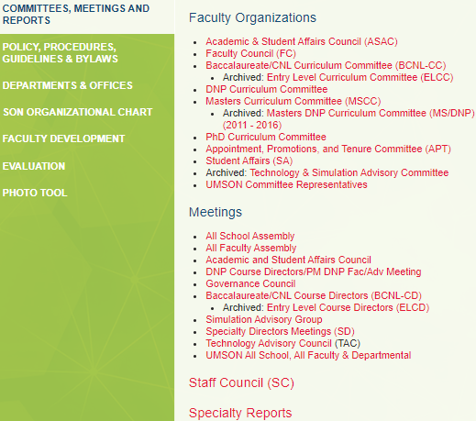
UMSON Intranet
The UMSON intranet is a secure storage location for information about the UMSON that is available to faculty and staff and can be accessed anywhere to locate important documents. Please note that you will need your username, password, and a 2-step verification to log-in. Then, you will be able to view the latest information on the following topics:
Committees, Meetings, and Reports (Faculty Council, Governance Council, etc.)
Policy, Procedures, Guidelines & Bylaws (Faculty Handbook, etc.)
Departments & Offices
SON Organizational Chart
Faculty Development (Promotion, Faculty Web Training, Degree Works, etc.)
Evaluation (Reports, Master Plans, Questionnaire, etc.)
And More!
See image of UMSON intranet below:
Notes:
UMSON Intranet
https://www.nursing.umaryland.edu/intranet/

Slide 21
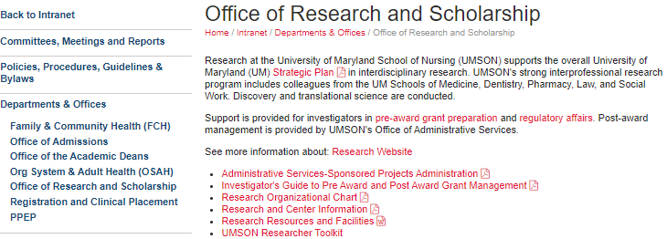
UMSON Research Information on the UMSON Intranet
See UMSON Research intranet. Please note that you will need your username, password, and a 2-step verification to log-in. Then, you will be able to view the latest information on the following topics:
Pre-Award Grant Preparation
Regulatory Affairs
Administrative Services-Sponsored Projects Administration
Investigator’s Guide to Pre and Post Award Grant Management
Research Resources and Facilities
UMSON Researcher Toolkit
And More!
Notes:
UMSON Intranet
https://www.nursing.umaryland.edu/intranet/departments-offices/office-of-research-and-scholarship/

Slide 22
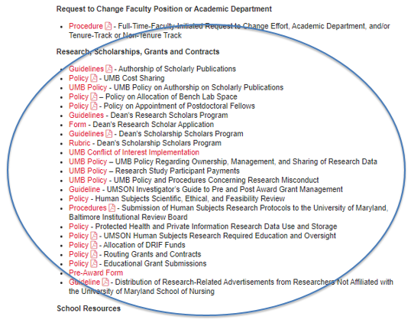
Important UMSON Research Policies and Procedures
The UMSON Research Policies and Procedures in the intranet can be found under “Research, Scholarships, Grants and Contracts” (see screenshot below):
Notes:
UMSON Research Policies and Procedures Intranet
https://www.nursing.umaryland.edu/intranet/policies-procedures-guidelines--bylaws/

Slide 23
Research and Development
Investigator Toolkit
The Research and Development’s Investigator Toolkit provides a list of helpful resources for investigators to utilize. This includes the following:
Center for Innovative Biomedical Resources (CIBR) – Lists core facilities and research support.
Communication – Helpful articles on the topic of research communication
File an Invention Disclosure – Lists forms, helpful information, as well as policies and procedures for UMB inventors
Find Funding Opportunities – Includes resources to facilitate the search for potential funding opportunities.
New to UMB – Provides information to assist with navigating sponsored programs
Principal Investigator Quick Reference – Reference for proposal development, submission, post-submission, award documentation, project management, financial management, and award closeouts.
Proposal Writing Resources – Various tips and tutorials to help writing an effective proposal such as planning your application, writing your application, sample proposals, rigor and transparency, 10 common grant-writing mistakes, among several others.
Research oversight – Contains information on conflict of interest, environmental health and safety, export compliance, human research protection, research integrity, and research policies.
Sponsor Review of Grant Proposals – Provides links to the grant review processes
Among others!
Note that UMSON also has a Researcher Toolkit that is different from the Research and Development Investigator Toolkit in that the UMSON toolkit contains guidance and training that focuses on human subjects-related research regulations, guidance, policies, presentations, and instructions; regulatory binders and subject binders, and quality assurance.
Notes:
Center for Innovative Biomedical Resources (CIBR)
https://www.medschool.umaryland.edu/CIBR/
Communication
https://www.umaryland.edu/ord/investigator-toolkit/communication/
File an Invention Disclosure
https://www.umventures.org/for-inventors/disclosures/Baltimore
Find Funding Opportunities
https://www.umaryland.edu/ord/investigator-toolkit/find-funding-opportunities/
New to UMB
https://www.umaryland.edu/ord/investigator-toolkit/new-faculty-at-umb/
Principal Investigator Quick Reference
https://www.umaryland.edu/ord/investigator-toolkit/principal-investigator-quick-reference/
Proposal Writing Resources
https://www.umaryland.edu/ord/investigator-toolkit/proposal-writing-resources/
Research oversight
https://www.umaryland.edu/ord/investigator-toolkit/research-oversight/
Sponsor Review of Grant Proposals
https://www.umaryland.edu/ord/investigator-toolkit/proposal-review/

Slide 24
Sponsored Programs Administration (SPA): Departing PI Award Disposition
The Sponsored Programs Administration (SPA)
The SPA provides oversight and administrative support to investigators throughout the duration of proposal and award. See helpful links below:
Departing PI Award Disposition Notification Form – This form is used when PI leaves UMB/UMSON to ensure that appropriate paperwork is completed to transfer award to institution.
Departing PI Award Disposition Procedures – This link provides information for appropriate dispositions for a faculty member, as a named Principal Investigator (PI) for a sponsored award leaves the University of Maryland, Baltimore (UMB).
The SPA is the institutional official that can be contacted to sign/submit changes to grants, data use agreements, materials to granting agencies, etc. In most cases, grants and agreements must be with the institution, not the individual faculty member. The Office of Administration, Amy Connor, BA, CRA, will route the letter, CV, among other required documents in Kuali as a change of PI to submitted proposal.
SPA Contact Information
UMSON: Team White
Grants: Christine Toalepai (Lead), Towanda Gilliam, Michael Starace, (T-Nesha) Odessa Neale
Contracts: Stacey Boyd, Emmanuel Shodeinde
Subawards: William Hugo
team-white@ordmail.umaryland.edu
Notes:
Departing PI Award Disposition Notification Form
https://www.umaryland.edu/spac/sponsored-projects-accounting-and-compliance-spac/departing-pi-award-disposition-notification/
Departing PI Award Disposition Procedures
https://www.umaryland.edu/policies-and-procedures/library/research/procedures/sponsored-projects/departing-pi-award-disposition.php
Sponsored Programs Administration
https://www.umaryland.edu/spa/

Slide 25
ORS Contact Information
Ayamba Ayuk-Brown, MBA - Business Operations Manager
  ayamba.ayuk@umaryland.edu
TBD – Statistician
  @umaryland.edu
Erika Friedmann, PhD – Professor & Associate Dean for Research
  friedmann@umaryland.edu
Casey Jackson, MS, CCRP - Research Quality Manager
  casey.jackson@umaryland.edu
TBD - Program Specialist
  @umaryland.edu
Jadyn Stewart, MPS, - Research Grants and Contracts Coordinator
  jadyn.stewart@umaryland.edu
Shijun Zhu, PhD, DrE - Associate Professor & Statistician
  shijun.zhu@umaryland.edu
Notes:
ORS Contact Information
https://www.nursing.umaryland.edu/research/contact-us/

