Slide 1
Nursing’s Journey to Excellence:
A Community of Practice That Is Diverse And Inclusive
Phyllis W. Sharps, PhD, RN, FAAN
Elsie M Lawler Endowed Chair
Professor and Associate Dean
Community Programs and Initiatives
Johns Hopkins School of Nursing

Slide 2
Presentation Objectives
Compare and contrast recent demographic changes in the United States population and the nursing workforce
Discuss the case for a diverse and inclusive nursing workforce
Describe the characteristics of a diverse and inclusive nursing workforce and its association with excellence in nursing

Slide 3
Nursing’s History
Long history – a nurse described in the New Testament (Phoebe) – and much history before the 1600’s
Nursing’s background associated with:
    Religious orders - including in Europe -Catholicism, Protestantism and Middle East East (Islamic)
    Military - much of war histories include descriptions of nurses both men and women
    Untrained individuals - providing care to the poor, military
Modern nursing most often credited to Florence Nightingale ~1855
But there were many other courageous nurses

Slide 4
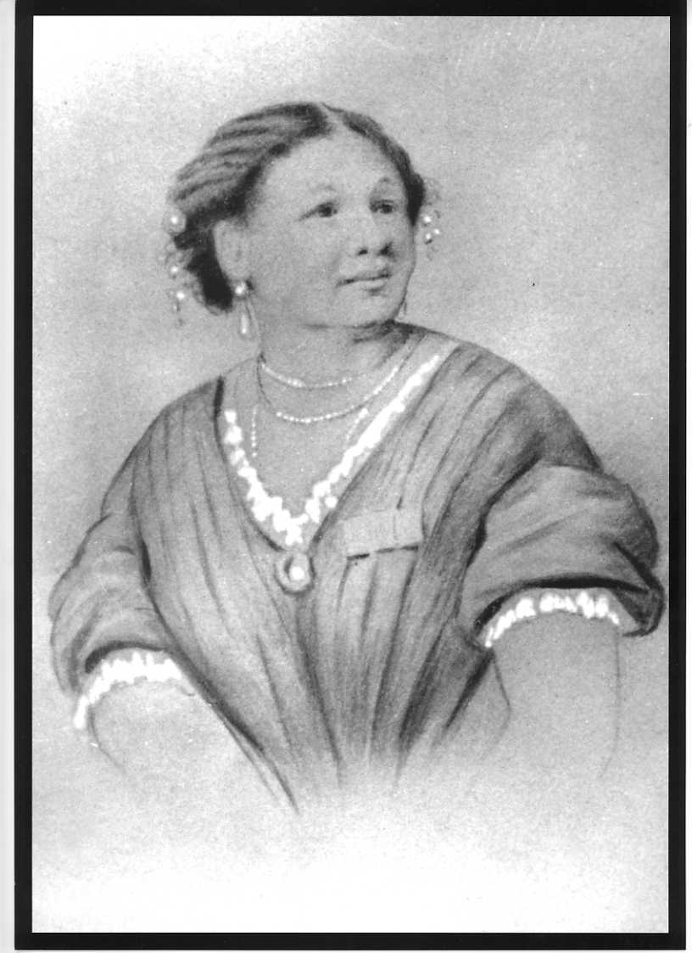
MARY SEACOLE
1805 - 1881
Mary Seacole's reputation after the Crimean War (1853-1856)rivaled Florence Nightingale's. Unlike Nightingale, Seacole also had the challenge to have her skills put to proper use in spite of her being black. A born healer and a woman of driving energy, she overcame official indifference and prejudice. She got herself out to the war by her own efforts and at her own expense; risked her life to bring comfort to the wounded and dying soldiers; and became the first black woman to make her mark on British public life. But while Florence Nightingale has gone down in history and become a legend, Mary Seacole was relegated to obscurity until recently.

Slide 5
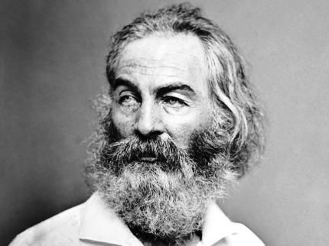
Walt Whitman
Walt Whitman, the world-renowned writer and poet, was also very active in caring for soldiers during the Civil War. He has been described as either a famous nurse or a dedicated visitor, but research shows that no one was more concerned for the welfare of the sick and wounded than Whitman.

Slide 6
Nursing’s History
1872 – first training schools for nursing established and they were hospital based in Boston
1873 – more training schools opened in Boston, NYC, Connecticut
Nursing Reflected the times
  Hospitals and training schools were segregated
  Nurses of color were barred and denied admission to training schools
1891 - First training school opened for African American Nurses in Chicago

Slide 7
Nursing’s History
Nursing Continued to Reflected the prevailing attitudes to people of color
  1879 – Mary Eliza Mahoney – first AA nurse to graduate – New England Hospital Training School
    ANA slow to admit nurses of color and although Ms Mahoney was a member she stood with & strongly other colored nurse graduates when in 1909 they established National Association of Colored Graduate Nurses – which eventually became the National Black Nurses Association
  1953 – Ester Mc Creedy was the first graduate of the UMSON
  1959 – Gertrude Jones Hodges – first AA graduate of the JHSON

Slide 8
Nursing Today
Established as a discipline
Many nurse are educated in universities and colleges
More nurse are achieving master’s and doctoral education
Advanced practice nurses are valued members of health care teams and health systems
Nurses are scientists – independently funded researchers – many through NINR and NIH
Nursing has established professional organizations, certifying and accrediting bodies

Slide 9
Nursing Today
Nurses care for diverse patient populations
  Ethnic/racial, age, gender, SES, urban, rural, cultural, religious
  Nursing curricula place emphasis on caring for diverse patient populations
Nurses are favorably viewed by the public
Past 17 years - 84% of the public rank Nurses #1 as the most trusted and ethical profession (N. McCarthy, Forbes, 2019)

Slide 10
Despite Changing Demographics in US population
True demographic representation remains an elusive goal for nursing

Slide 11
Demographics
USA Population and Nurses

Slide 12
Population and Nurse Diversity

Slide 13
Percentages of Nurses By Racial/Ethnic Background

Slide 14
Percentage of Nurses By Gender
(Pre-Licensure Grads, 2017)

Slide 15
Racial and Ethnic Breakdown of APRNs
Race/Ethnic | US Population | NP & NM | CNS | NA
White | 73.3% | 85.7% | 85% | 87%
Latinx | 17.3%* | 3.4%** | 2.8% | --
Black | 12.6% | 6.6% | 4.2% | 7%
Asian | 5.2% | 5.8% | 3.3% | 4%
Multi-Ethnic | 3.1% | 1.2% | 1.4% | 1%
Native Am | 0.8% | 0.2% | 0.3% | --
Other | 4.8% | 0.6% | -- | 1%

Slide 16
Racial and Ethnic Breakdown of APRN Faculty Roles
Race and Ethnicity | Full-Time NEs | Chief Administrators | Professors
White | 81.9% | 88.3% | 84.5%
Latinx | 3.7% | 3.0% | 2.4%
Black | 8.4% | 4.5% | 8.7%
Asian | 2.7% | 1.4% | 2.7%
Two or More | 0.6% | 1.0% | 0.2%
Native American | 0.4% | 1.3% | 0.1%
Other | 2.3% | 0.6% | 1.4%

Slide 17
Nurse Leaders

Slide 18
Why Diversity Matters
The Case for a More Diverse Workforce

Slide 19
Why Diversity
To better meet America's health needs and contribute to a Culture of Health, the nursing workforce needs to reflect the great multitude of ethnicities, races, and cultures within the country's communities.
With a more diverse pool of APRNs and other advanced practice providers, faculty, researchers and administrators:
  underserved populations can receive expanded services
  more research can be conducted on neglected populations managers
  policymakers can better represent the voices and needs of vulnerable communities.

Slide 20
The Way Forward
Nursing Can Lead the Way - in
Diversity – Equity – Inclusion

Slide 21
Nursing Can Lead
Nursing has the Social Capital to Lead
  Consistently viewed as the most trusted-honest – ethical profession
  Nursing’s Code of Ethics – charges us to advocate for Social promoting diversity-equity - inclusion
  Nursing's curriculum emphasizes and integrates concepts of diversity-equity- inclusion – cultural competency – dignity and respect for all people
  Nursing can be a profession that is diverse- promotes equity - inclusion for all members in all roles and settings

Slide 22
Social Justice in Nursing
Social Justice has always been a core value of nursing
Social Justice is also reflected in ANA Code of Ethics (9 Provisions)
Provision 1: The nurse practices with compassion and respect for the inherent dignity, worth, and unique attributes of every person.
Provision 3: The nurse promotes, advocates for, and protects the rights, health, and safety of the patient.
Provision 8: The nurse collaborates with other health professionals and the public to protect human rights, promote health diplomacy, and reduce health disparities
Provision 9: The profession of nursing, collectively through its professional organizations, must articulate nursing values, maintain the integrity of the profession, and integrate principle of social justice into nursing and health policy.

Slide 23
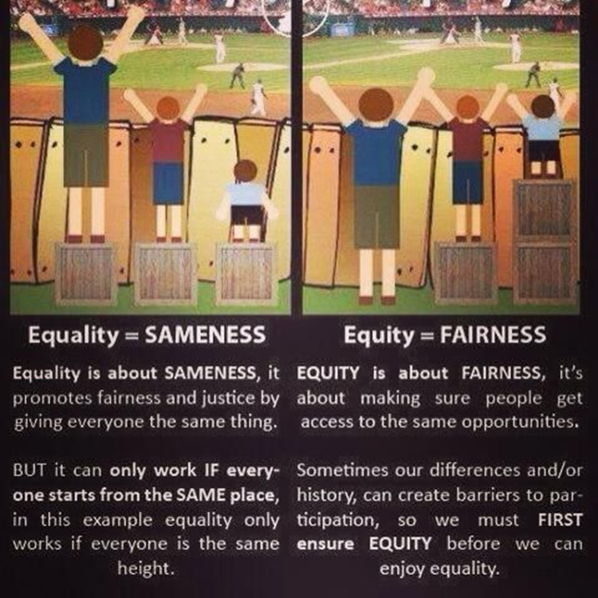

Slide 24
Expand Definitions of Diversity
Understanding, accepting, and valuing differences between nurses of different races, ethnicities, genders, ages, religions, disabilities and sexual orientations, as well as differences in personalities, skills sets, experiences and knowledge bases

Slide 25

2019 Best Strategies for Increasing Diversity
Adopt expanded definition of diversity
Use technology (AI) to avoid unconscious bias (sort by other criteria, metrics regarding the pool of candidates, students)
Student and faculty candidates with non-traditional backgrounds, credentials
Test Diversity Initiatives with Data – do strategies result in changes, meeting goals
Interview process – standardize and training
Personal Incentives and Accountability of diversity-equity and inclusion outcomes

Slide 26
Promote Minority Nurse Leadership Development
Encourage and support leadership training
Reduce social isolation – focus on assisting with building professional support systems (minority nurse professional associations, buddy systems )
Increase use of mentors for new minority graduates and novice nurses (committed to goals of promoting, leadership, mentee may progress beyond the mentor!!)
Develop work environment that documents, supports, evaluates recruitment, retention and advancement of minority nurses (metrics and accountability matter)

Slide 27
Strategies for Nursing Education
Create a culture that values and recognizes need for diverse faculty and student
Create a culture that is committed to optimal outcomes for academic achievement for diverse students
Create a culture that is committed to professional development and advancement up the academic ranks for diverse faculty
Avoid the “Brown tax” for diverse faculty
Continue to fully integrate cultural competency all aspects of the curriculum (e.g. ethnic/racial, gender, religious, age language, communication, interventions) - avoid reinforcing stereo-typing and bias

Slide 28
Nursing Faculty Strategy:
Formal Mentoring
Mentor is:
  Superior status and achievement but committed to development of mentee
  Guides the personal and professional development of another person (mentee)
Mentoring is critical to success
Mentoring has often been through informal networks
Recognition of its value - recent trends establishing more formal mentoring structures
Industry, federal government, universities and professional associations recognize value and developing formal and accountable mentoring structures

Slide 29
Nursing Faculty Strategy:
Formal Mentoring
Nursing professional organizations can continue to assume major roles
  Academic settings
  Health care settings
Examples
  Minority Nursing Associations - NBNA, Filipino, Hispanic, Asian/Pacific Islander, Men in Nursing, Coalition of Ethnic Minority Nurse Association
  Other Professional organization mentoring for research and leadership – such as ONS, AACN, NLN
    ANA-SAMHSA Ethnic Minority Fellowship Program
Robert Wood Johnson Foundation
      Clinical Scholars
      Culture of Health leaders
      Health Policy Research Scholars
      Interdisciplinary Research Leaders

Slide 30
Strategies for Nursing Faculty: Mentor
1. Teaching and guiding
2. Advising and counseling
3. Sponsoring and protecting
4. Role modeling
5. Validating
6. Challenge
7. Motivating
8. Encouraging
9. Communicating
10. Invisibility
11. Identify professional
contacts and networking
opportunities
12. Genuine commitment to
successful achievement of the
mentee

Slide 31
Strategies for Nursing Faculty:
Mentee
1. Positive attitude
2. Willingness to learn, listen
and act on useful advice
3. Develop proficiency in
certain academic,
professional and scholarly
skills
4. Dependability in completing
assigned tasks
5. Receptive to meaningful criticism
6. Surpass the mentor’s expectations for
performance
7. Comfortable in expressing concerns
to mentor
8. Realistic expectation – understand
mentor, context of relationship,
other factors (gender, race, politics)

Slide 32
Diversity – Equity- Inclusion
“CONSTITUENCIES OF THE POOR AND POWERLESS MUST PROVE THEIR CASE FOR CHANGE
(URM leaders, faculty, and students in nursing)
THE RICH AND POWERFUL DO NOT NEED HARD DATA TO MAINTAIN THE STATUS QUO” (Nancy Milio)
(Euro Am leaders, policy-makers, faculty, and students in nursing)

Slide 33


Nursing’s Future is Bright
Nursing Can Lead the Way
Thank You

