Slide 1
Stepwise Approach to Building Sustainable Models of Interprofessional Education and Collaborative Care in Ambulatory Community Settings
Gina Rowe, PhD, DNP, MPH, APRN,BC, PHCNS-BC, CNE
Assistant Professor and Family Nurse Practitioner
Coordinator, DNP/FNP Program at Shady Grove
University of Maryland School of Nursing
Heather Brennan Congdon, PharmD, BCPS, CDE, FNAP
Assistant Dean for Shady Grove, University of Maryland School of Pharmacy
Co-Director, University of Maryland, Baltimore Center for Interprofessional Education

Slide 2
Involved IPE Team at the Universities at Shady Grove
Barbara Nathanson, MSW, LCSW-C
Katherine J. Morris, MSW, LCSW-C
Joan Pittman, PhD, MSW, LCSW-C
Jana Goodwin, PhD, RN, ANCP
Rebecca Wiseman, PhD, RN

Slide 3
Objectives
Interprofessional Education (IPE)
Definitions
Rationale/drivers
Stepwise Progression in Montgomery County
Mercy Health Clinic
Holy Cross Hospital Outpatient Clinics
National Center Training and Future Progression

Slide 4
IPE IS NOT…
Students from different health professions in the same classroom without reflective interaction.
Pharmacy student
Nursing student
Medical student
Social Work student
Notes:
4

Slide 5
IPE IS NOT…
A faculty member from one profession leading a classroom learning experience for students of another profession.
Pharmacy professor
Social Work students
Notes:
5

Slide 6
IPE IS NOT…
A session in a patient care setting led by an individual from another profession without sharing of decision making or responsibility for patient care.
Nursing professor
Patient
Pharmacy students
Notes:
6

Slide 7
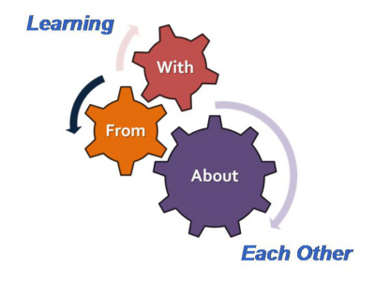
IPE IS…
When two or more professions learn with, from, and about each other to improve collaboration and the quality of care.
Centre for the Advancement of
Interprofessional Education, UK
Picture credit: http://www.aippen.net
Notes:
7

Slide 8
IPE IS…
Educators and learners from two or more health professions and their foundational disciplines who jointly create and foster a collaborative learning environment.
2005-2006 AACP COF Interprofessional Education Task Force
Notes:
8

Slide 9
What Drives Interest in IPE?
Health professionals expected to work in teams
But students rarely taught how to do so in school
Potential to influence healthcare quality, costs, and outcomes
Reeves, S., et al. (2016). BEME systematic review of the effects of interprofessional education
Bradley, E.H. and Taylor, L.A. (2013). The American health care paradox: Why spending more Is getting us less. New York, NY: Public Affairs.

Slide 10
Organizational Interest in IPE
Healthcare Environment
Nursing
Institute of Medicine reports
To Err is Human, 1999
Institute of Healthcare Improvement
Triple Aim Initiative, 2007
National Legislation
Affordable Care Act, 2010
Medicare Access and CHIP Reauthorization Act (MACRA), 2015
Accreditation Standards
Competencies
IPEC Core Competencies
NACE Competencies
American Association of Colleges of Nursing
Essentials of Baccalaureate (2008), Masters (2011) and Doctoral (2006) Education
Quality and Safety Education for Nurses
Entry-level and Graduate Competencies, 2007, 2012
Professional Competencies, e.g., National Organization of Nurse Practitioner Faculty
NP Core Competencies, 2012, 2017
Institute of Medicine
The Future of Nursing: Leading Change, Advancing Health, 2010

Slide 11
Nursing and Interprofessional Education Collaborative (IPEC) Essentials and Competencies
Nursing Competencies
IPEC Competencies
AACN Essentials
Quality improvement and safety
Inter-professional communication/collaboration
QSEN
Teamwork and collaboration
Safety
NONPF Competencies
Collaboration and coordination
Ethics
Values and Ethics
Roles/Responsibilities
Interprofessional Communication
Teams and Teamwork

Slide 12
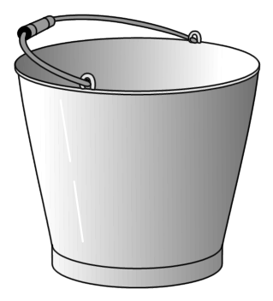
“Buckets” of IPE: Where Does IPE in Practice Fit?
EXPOSURE
IMMERSION
COMPETENCE

Slide 13
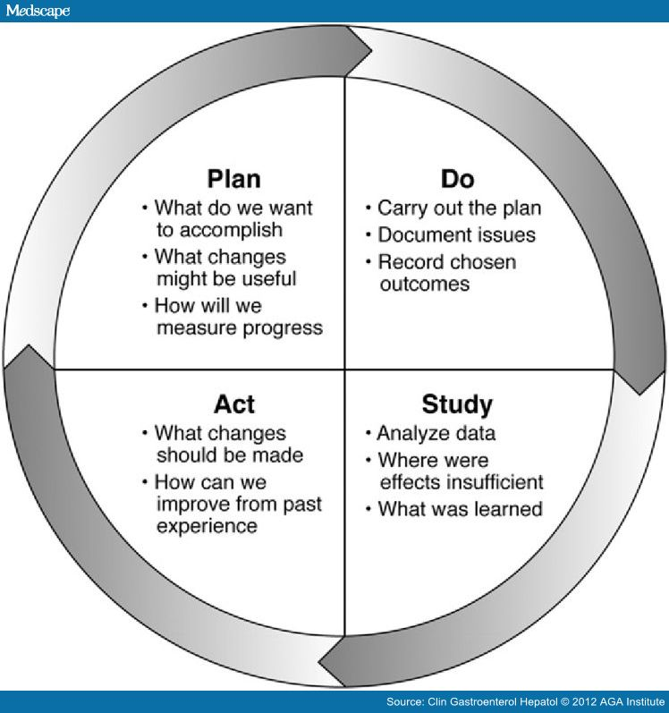
Stepwise Approach to Sustainable Model of IPE and IPC (Competence)
Start small - pilot
Go slow
Build upon successes
Learn from pitfalls
Assess!
PDSA

Slide 14
Mercy Health Clinic
One of 12 safety-net clinics in the Montgomery Care program of the Primary Care Coalition of Montgomery County
Serves low income, uninsured patients
Provides a variety of services
Primary preventative care
Diagnosis and treatment of general acute and chronic medical problems
Management of chronic medication conditions
Referrals for consultation

Slide 15
Goals of IPE Clinic at MHC
To enhance and expand care for medically complex, uninsured, ethnically diverse patients through coordinated interprofessional care.
To educate and train healthcare professional students from pharmacy, nursing, and social work programs at the University of Maryland, Baltimore (UMB) and the University of Maryland, Baltimore County (UMBC) to efficiently and effectively provide coordinated care through mastery of the Interprofessional Education Collaborative (IPEC) Core Competencies for Interprofessional Practice.

Slide 16
IPE Clinic Details
IPE Clinic began in Fall 2014
Pharmacy
Nursing (RN to BSN; added DNP in fall '16)
Social Work (BSW and MSW)
Examples of interventions made by IPE Clinic
Medication and chronic condition education
Medication adjustment to reach therapeutic goals
Enhanced access to medication, food and clothes
Referrals to specialty clinics, screening, etc.

Slide 17
IPE Clinic Results: Relative Frequency of Interventions Made at MHC

Slide 18
TSS
Grymonpre, R., van Ineveld, C., Nelson, M., Jensen, F., De Jaeger, A., Sullivan, T., Weinberg, L., Swinamer, J., and Booth, A. (2010). See it – Do it – Learn it: Learning interprofessional collaboration in the clinical context. Journal of Research in Interprofessional Practice and Education, 1(2), 127-­144.
 | Survey Item | N pre | N post | Pre | Post | P value
1 | Function effectively in an interdisciplinary team | 18 | 15 | 3.7 | 4.2 | 0.06
2 | Treat team members as colleagues | 18 | 16 | 4.3 | 4.6 | 0.5
3 | Identify contributions to patient care that different disciplines can offer | 18 | 16 | 3.7 | 4.6 | 0.003
4 | Apply your knowledge to caring for a person in the team care setting | 18 | 16 | 3.8 | 4.5 | 0.01
5 | Ensure that patient/family preferences/goals are considered when developing the team’s care plan | 18 | 15 | 4 | 4.47 | 0.09
6 | Handle disagreements effectively | 18 | 16 | 3.9 | 4.2 | 0.34
7 | Strengthen cooperation among disciplines | 17 | 14 | 3.7 | 4.6 | 0.001
8 | Carry out responsibilities specific to your discipline’s role on a team | 18 | 16 | 3.8 | 4.6 | 0.004
9 | Address clinical issues succinctly in interdisciplinary meetings | 18 | 16 | 3.9 | 4.4 | 0.04
10 | Participate actively at team meetings | 18 | 16 | 4.1 | 4.4 | 0.33
11 | Develop an interdisciplinary care plan | 17 | 15 | 3.7 | 4.2 | 0.1
12 | Adjust your care to support the team goals | 15 | 16 | 3.7 | 4.4 | 0.02
13 | Develop intervention strategies that help patients attain goals | 17 | 16 | 3.8 | 4.4 | 0.04
14 | Raise appropriate issues at team meetings | 18 | 16 | 3.6 | 4.4 | 0.01
15 | Recognize when the team is not functioning well | 16 | 16 | 3.8 | 4.3 | 0.15
16 | Intervene effectively to improve team functioning | 18 | 15 | 3.6 | 4.1 | 0.09
17 | Help draw out team members who are not participating actively in meetings | 18 | 16 | 3.1 | 4.2 | 0.002

Slide 19
Expanding the Pilot
National Center for Interprofessional Practice and Education* grant
2016 “Accelerating Interprofessional Community-Based Education and Practice”
Goal: Develop innovative, creative and sustainable community-based clinical initiatives to accelerate existing IPE
Eligible applicants: Health/professional schools, with a history of collaboration, working with a community partner and its clients
PI – Graduate nursing
Two additional safety-net community health center sites
Narrowed focus: uncontrolled diabetes and depression/anxiety
Now track A1C and PHQ-9
*HRSA Cooperative Agreement Award No. UE5HP25067; Josiah Macy Jr. Foundation, Robert Wood Johnson
Foundation, Gordon and Betty Moore Foundation, John A. Hartford Foundation, University of Minnesota

Slide 20
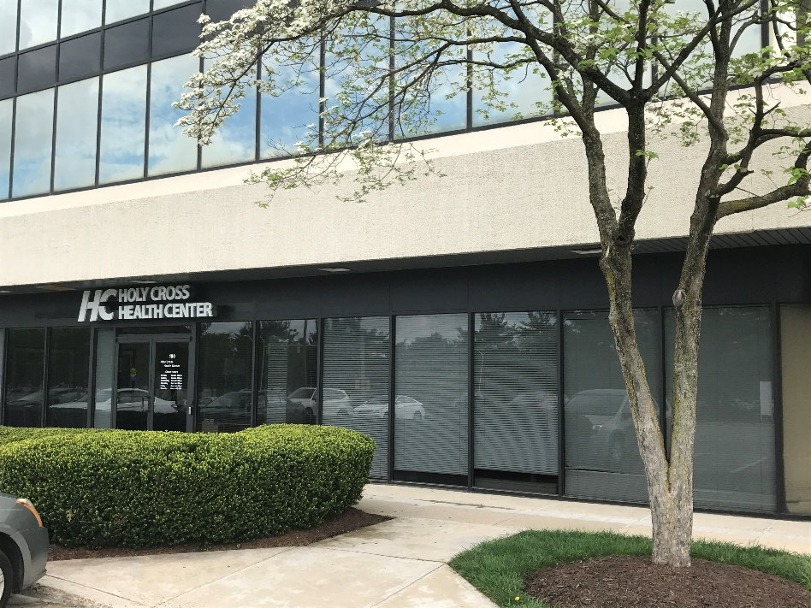
Holy Cross Hospital Outpatient Clinics
Gaithersburg, Montgomery County, MD
Target Population: immigrant, Hispanic, uninsured or Medicaid, diagnosed with DMT2/depression
Evolution: from “interventions & referrals” to clinical outcomes
Cultural competence & care coordination

Slide 21
Lessons Learned To Date
Successes
Challenges
Patient recruitment
Graduate student involvement
5-6 each - nursing, pharmacy and social work students
Student outcomes
Patient outcomes (qualitative)
Clinic staff turn-over
Undergraduate student involvement
2 social work, 1 RN-BSN
Standardization of student recruitment
Time

Slide 22
Looking to the Future
Expansion to 3rd health center in Fall, 2017.
Larger external grants to support IPE and IPC.
Expand to additional safety-net community health clinics in Montgomery County.
Train clinical preceptors to replicate IPE Clinics.
National Center for IPE: Interprofessional Learning IN Practice for Preceptors and Site Development

Slide 23
Select References
American Association of Colleges of Nursing. (2011). The essentials of baccalaureate education for professional nursing practice. From: http://www.aacn.nche.edu/education-resources/BaccEssentials08.pdf
American Association of Colleges of Nursing. (2006). The essentials of doctoral education for advanced nursing practice. From: http://www.aacn.nche.edu/publications/position/DNPEssentials.pdf
American Association of Colleges of Nursing. (2011). The essentials of masters education in nursing. From: http://www.aacn.nche.edu/education-resources/MastersEssentials11.pdf
Bradley, E.H. and Taylor, L.A. (2013). The American health care paradox: Why spending more Is getting us less. New York, NY: Public Affairs.
Commonwealth Fund. (2015). U.S. healthcare from a global perspective. (2015). From: http://www.commonwealthfund.org/publications/issue-briefs/2015/oct/us-health-care-from-a-global- perspective
Institute for Healthcare Improvement. (2017). The IHI Triple Aim Initiative. From: http://www.ihi.org/engage/initiatives/TripleAim/Pages/default.aspx
Institute of Medicine. (2010). The Future of Nursing: Leading Change, Advancing Health. From: http://nationalacademies.org/hmd/reports/2010/the-future-of-nursing-leading-change-advancing-health.aspx
Interprofessional Education Collaborative. (2016). Core competencies for interprofessional collaborative practice: 2016 Update. From: http://www.aacn.nche.edu/education-resources/IPEC-2016-Updated-Core-Competencies- Report.pdf
National Organization of Nurse Practitioner Faculties. (2012). Nurse practitioner core competencies. From: http://www.nonpf.org/?page=14
QSEN Institute. (2007, 2012). QSEN competencies. From: http://qsen.org/
Reeves, S., et al. (2016). A BEME systematic review of the effects of interprofessional education: BEME guide no. 39. Medical Teacher, 38(7), 656-668.

Slide 24
Questions? Heather Congdon –hcongdon@rx.umaryland.edu Gina Rowe – rowe@son.umaryland.edu

